Slide 1
Principles of multimedia
Week 7
RLE and Huffman coding
Specifics & Examples from the JPEG standard &
http://users.ece.utexas.edu/~ryerraballi/MSB/pdfs/M4L1.pdf

Slide 2
Difference Coding
Encode :
Diff_{i} = DC_{i} − DC_{i−1}
Decode :
DC_{i} = DC_{i−1} + Diff_{i}
Diff_{i−1}=
DC_{i−1} −DC_{i−2}
Diff_{i}=
DC_{i} −DC_{i−1}
Diff₁=DC₁
DC₀
DC₁
…
DC_{i−1}
DC_{i}
…
0
…
…
block 1
block i−1
block i
Figure 5. DCs of 8×8 blocks

Slide 3
Huffman Coding – DC coefficient
The DPCM value of the DC coefficient is encoded as a size, value pair.
The code representing a value is a concatenation of a code corresponding to size and another corresponding to value.
The tables in the next two slides show these parameters.
The codes are for the luma component.

Slide 4
Huffman Coding
Size | Values | Bits for the value
0 | 0 | ---
1 | -1,1 | 0,1
2 | -3,-2,2,3 | 00,01,10,11
3 | -7,-6,-5,-4,4,5,6,7 | 000,001,010,011,100,101,110,111
4 | -15,...,-8,8,...,15 | 0000,...,0111,1000,...,1111
5 | -31,...,-16,16,...31 | 00000,...,01111,10000,...,11111
6 | -63,...,-32,32,...63 | 000000,...,011111,100000,...,111111
7 | -127,...,-64,64,...,127 | 0000000,...,0111111,1000000,...,1111111
8 | -255,..,-128,128,..,255 | ...
9 | -511,..,-256,256,..,511 | ...
10 | -1023,..,-512,512,..,1023 | ...
11 | -2047,..,-1024,1024,..,2047 | ...
Table 7.1. Values and bits for the value

Slide 5
Huffman Coding
Size | code length | code word
0 | 2 | 00
1 | 3 | 010
2 | 3 | 011
3 | 3 | 100
4 | 3 | 101
5 | 3 | 110
6 | 4 | 1110
7 | 5 | 11110
8 | 6 | 111110
9 | 7 | 1111110
10 | 8 | 11111110
11 | 9 | 111111110
Table 7.2. Huffman table of luminance DC coefficients

Slide 6
Example of encoding DC coefficients.
If a DC component is 40 and the previous DC component is 48. The difference is -8.
It is coded as: 1010111
Where 0111 is the value representing -8 in Table 7.1. The table also shows that the size is 4.
Table 7.2 shows that 101 is the code corresponding to size 4. This is the first part of the code 1010111.

Slide 7
Zero Run Length Coding
The data arranged in Zig-Zag fashion is converted to pairs representing zero run length and the first non zero value. The longest run is limited to 15. See examples.
Example 1
63 AC coefficients:
57, 45, 0, 0, 0, 0, 23, 0, -30, -16, 0, 0, 1, 0, 0, 0, 0, 0, 0, 0,..., 0
Run Length Coding :
(0,57) ; (0,45) ; (4,23) ; (1,-30) ; (0,-16) ; (2,1) ; EOB
Example 2
63 AC coefficients:
57, 0, 0, ... , 0, 3, 0, 0, 0, 0, 2, 0, 0, ... , 0, 895, EOB
Run Length Coding :
(0,57) ; (15,0) ; (2,3) ; (4,2) ; (15,0) ; (15,0) ; (1,895) ; (0,0)
50 zeros
(0,0)
18 zeros
33 zeros

Slide 8
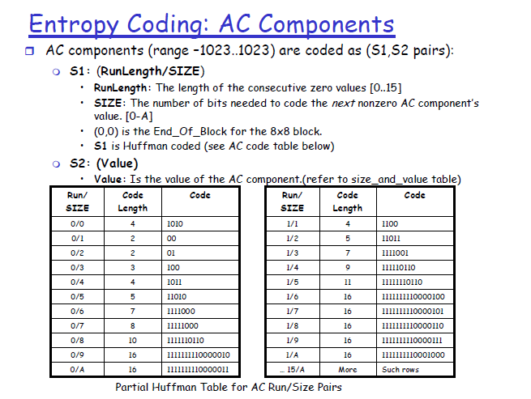
Note: O/0 used to indicate trailing sequence of zeros. See next slide.

Slide 9
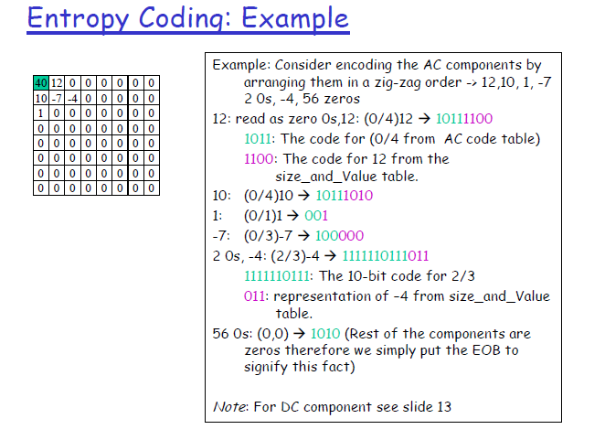
Source: http://users.ece.utexas.edu/~ryerraballi/MSB/pdfs/M4L1.pdf

Slide 10
Exercise
Assume the output of your quantization step results in data that can be encoded using the partial Huffman tables provided in this slide deck. Write code to encode and decode the block.
Design Huffman codes for a source whose symbol frequency distribution is the same as the distribution of the quantized DCT coefficients you get for one or more images. Use these Huffman codes to encode your image. Note: In this exercise we will not use the RLE idea.

